Slide 1

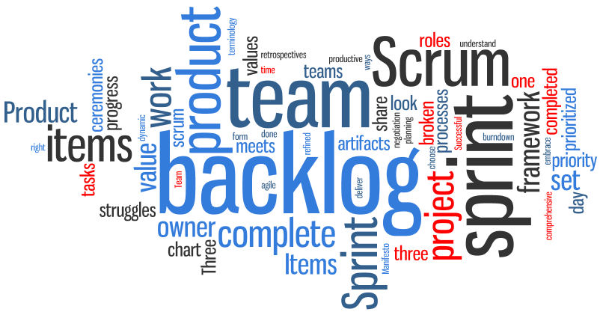
Sprint Three
Final Presentation
Notes:
‹#›
Hello everyone, this is the Initial plan report by Team 3. We pick up the outline and important information to show you because of limited time. As you see, the name of our product is ProPal. Here is the Logo, it is designed by Yansen our … leader.

Slide 2
Team members & Roles
Team Member | Roles | Scrum Roles
Dawei Li | Team Leader | P.O., Scrum Master
Xiang Chen | Config. L., Envir. L. | P.O., Developer
Yansen Liu | Design Leader | P.O., Developer
Yuhao Wu | Team Member | P.O., Developer
Weicheng Yu | Backup L., Security L. | P.O., Developer
Chen Shou | Requirement Leader | P.O., Developer
Lu Min | QA Leader | P.O., Developer

Slide 3

Introduction
Requirement
Design
Configuration
Testing
Security
Project Management
To Be Improved
Demo

Slide 4
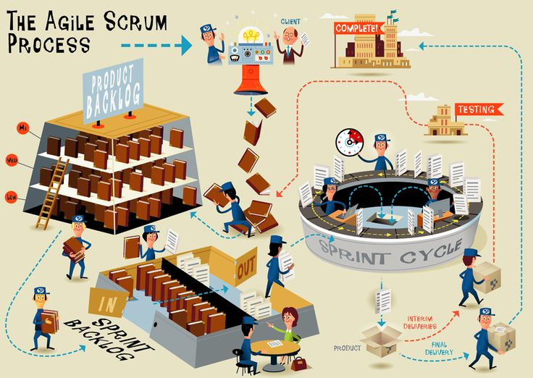
Product Overview
Web Application
Scrum Guiding
Documentation
Management
Access control

Slide 5
Requirement
Use case diagram
Class Diagram
State Diagram
Sequence Diagram
User Stories

Slide 6
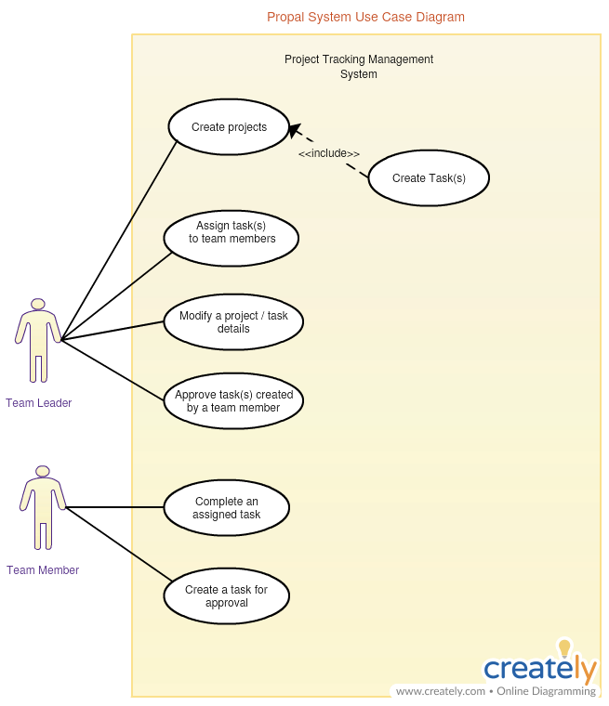
Use case diagram
Actors:
Team Leader, Team Member, Administrator(Not Implemented)
Extends:
Create projects owns Create Task(s) use case
Association
Notes:
Representing the goals of system-user interactions
Defining and organizing functional requirements in a system
Specifying the context and requirements of a system
Modeling the basic flow of events in a use case

Slide 7
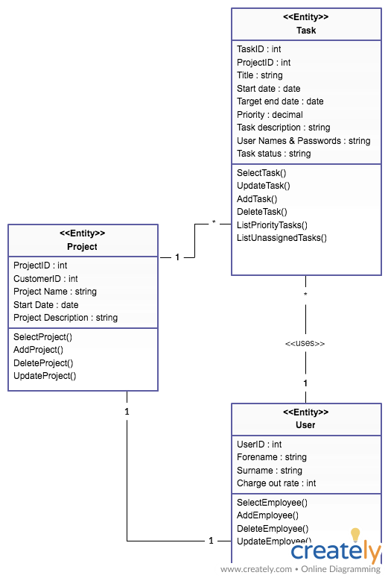
Class Diagram
Entity:
Project
Task
User
Dependencies
Association
Notes:
Illustrate data models for information systems.
Understand the general overview of an application's schematics.
Express the needs of a system and disseminate that information throughout the business.
Create detailed charts that focus on the programming code needed to implement the described structure.
Provide an implementation-independent description of types used in a system and passed between its components.

Slide 8
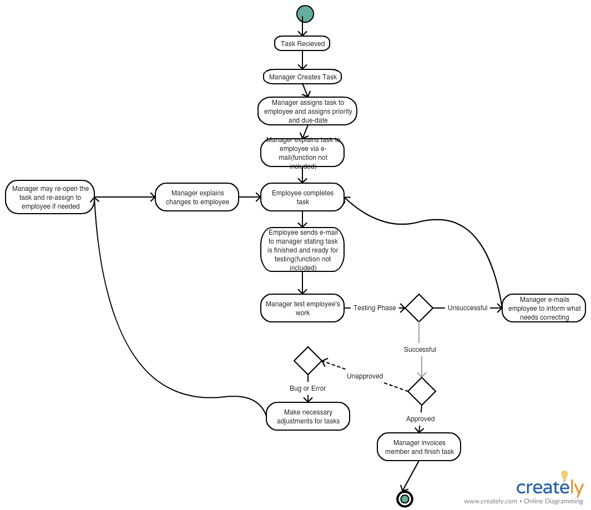
State Diagram
Transition
Initial State
End State
Notes:
A state diagram shows the behavior of classes in response to external stimuli. Specifically a state diagram describes the behavior of a single object in response to a series of events in a system. Class diagrams have a number of benefits for any organization. Try using them to:

Slide 9
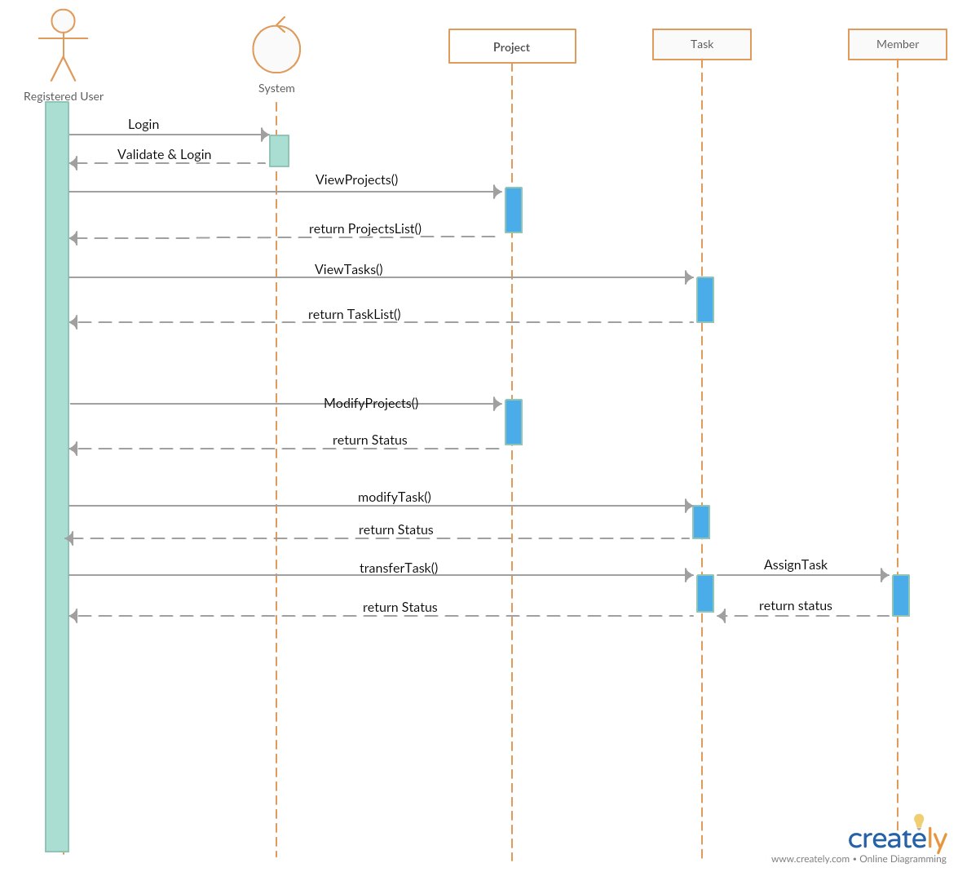
Sequence Diagram
Registered users
System
Project
Task
Member(Receiver)
Notes:
Sequence diagrams describe interactions among classes in terms of an exchange of messages over time. They're also called event diagrams. A sequence diagram is a good way to visualize and validate various runtime scenarios. These can help to predict how a system will behave and to discover responsibilities a class may need to have in the process of modeling a new system.

Slide 10
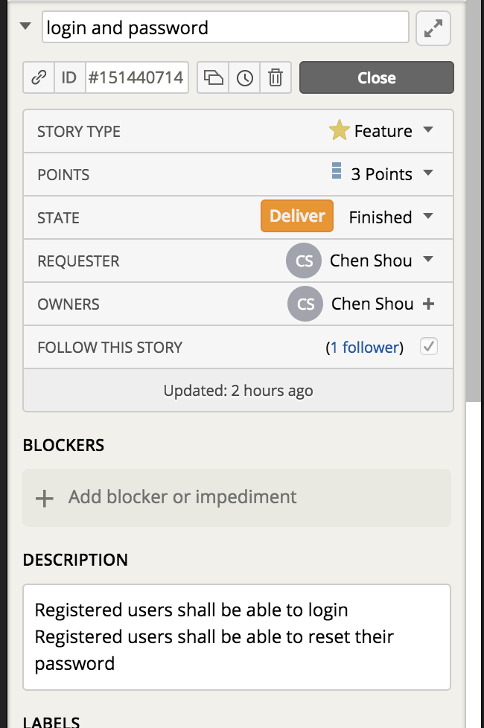
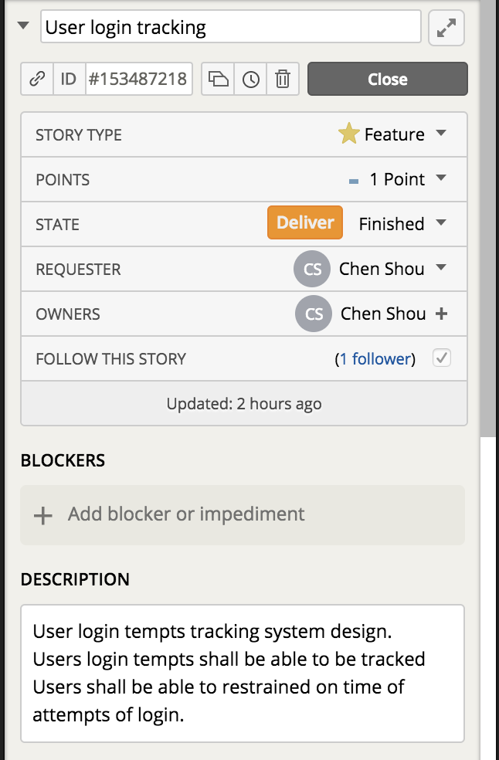
User Story Illustration

Slide 11
Design - Yansen Liu
Software Architecture
Model Database
Design Pattern
Class and Method
Algorithms Used

Slide 12
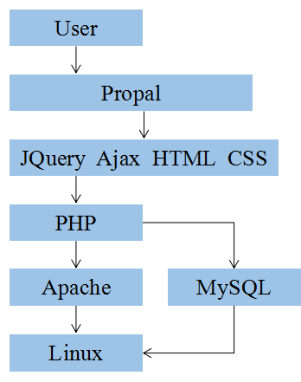
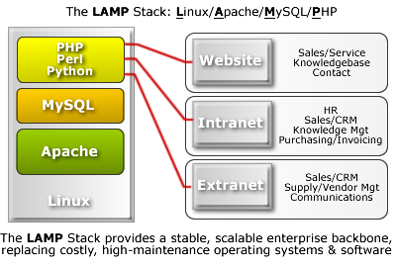
Software Architecture
*
Notes:
‹#›

Slide 13
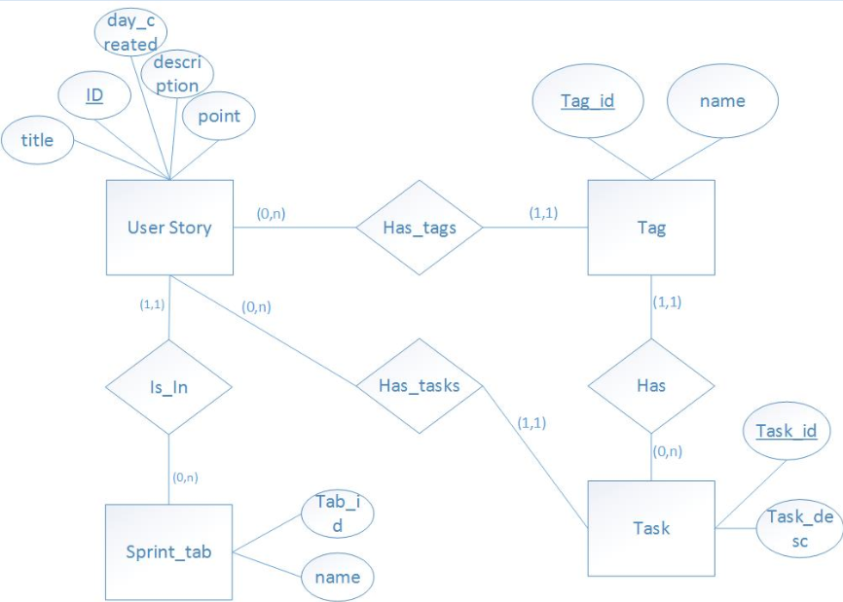
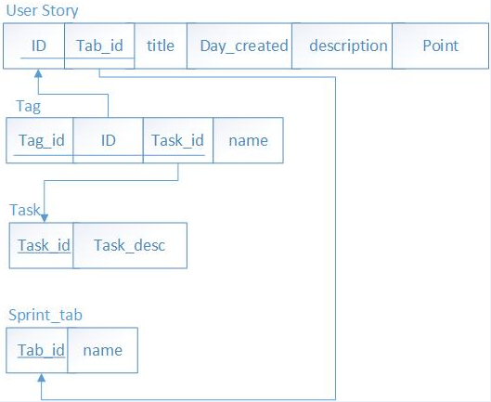
Model:
Database

Slide 14
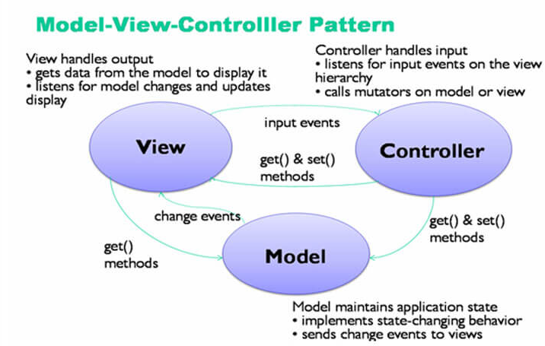
Design Pattern
Model | View | Controller
Database | UI, Web Interface | Business Logic
MySQL | HTML,CSS,Javascript,JQuery | PHP
Store all the data | Present the front-end web page | Exchange data between Model and View

Slide 15
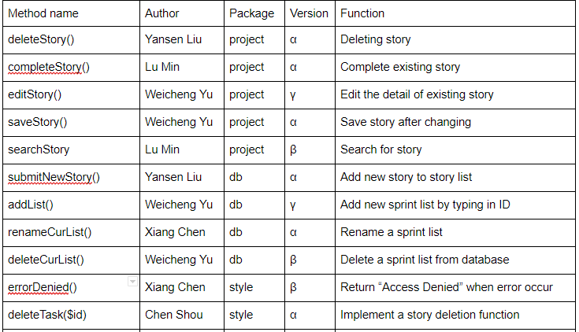
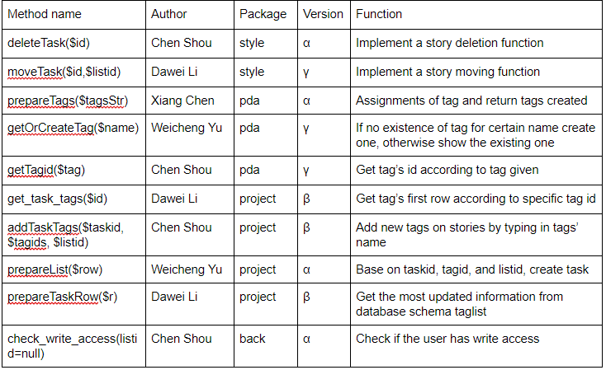
Class and Method

Slide 16
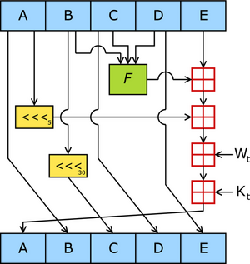
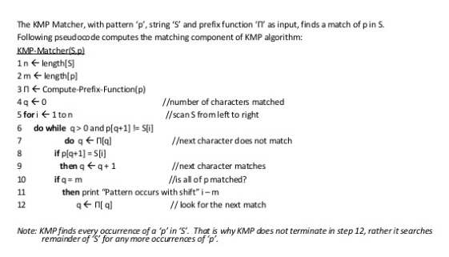
Algorithms Used
Sort algorithm
KMP matching
Hash algorithms

Slide 17
Configuration
Version Control
Code Review
Integration
Deployment
Project Structure
Techniques
Refactor

Slide 18

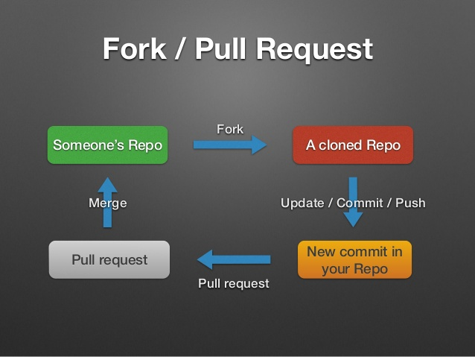
Version Control
Only configuration leader have the access to main account (Github)
Developers use their own github account to fork the project repository
Developers can create master and child branch on their own github and local machine
Developers can push to their own github account freely
If developers want to push to the main account, he or she has to pull new request on github, then configuration leader will check the code and decide if merge request or not
Since we use git and github, it is easy to rollback to specific version

Slide 19
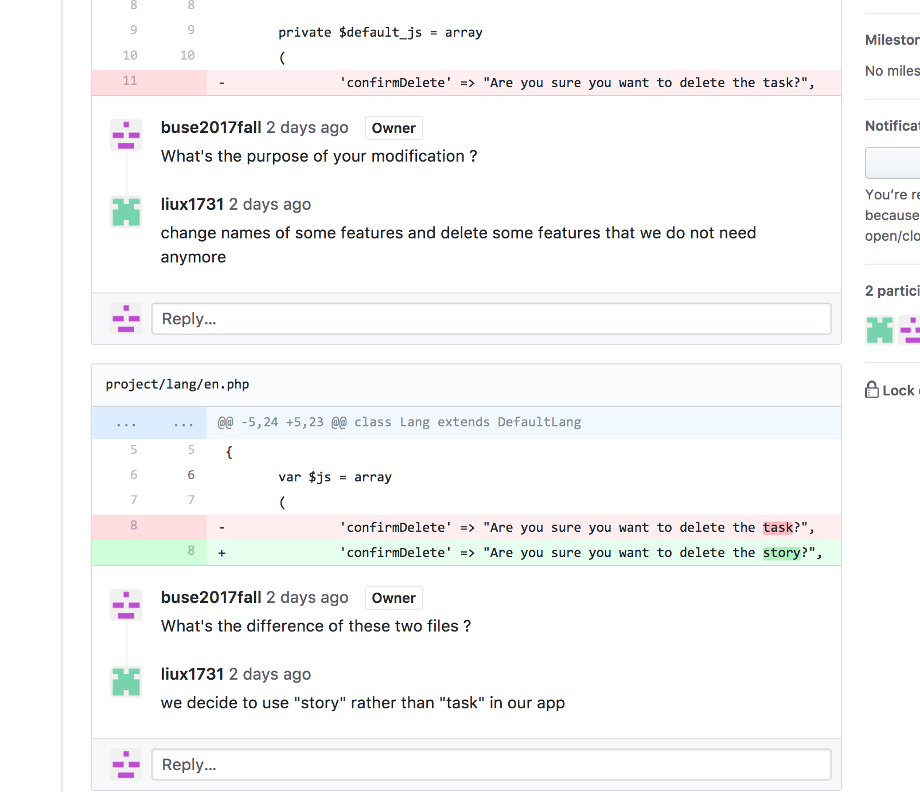
Code Review
*
Finding bugs early
Coding standards compliance.
Teaching and sharing knowledge.
Consistent design and implementation.
Higher software security.
Confidence of stakeholders
Notes:
‹#›

Slide 20
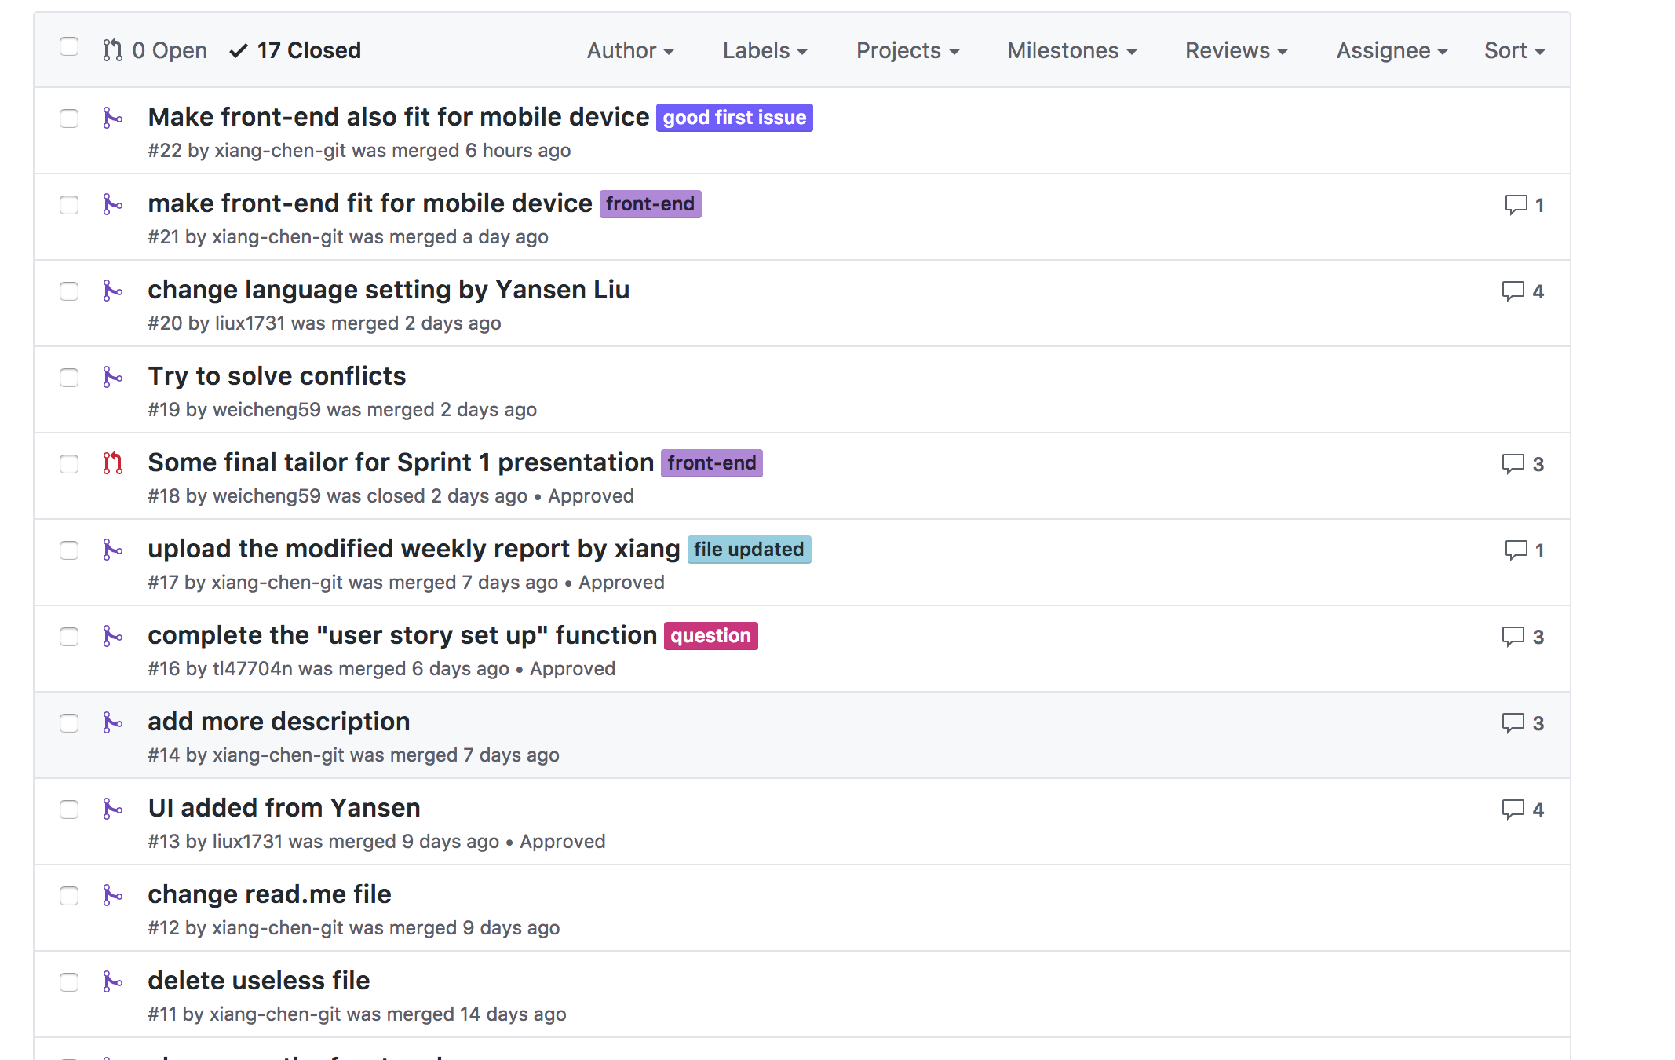
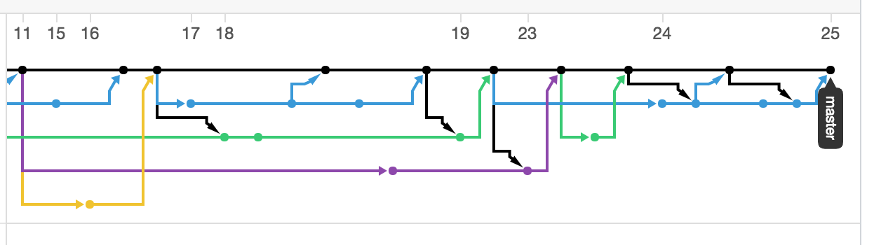
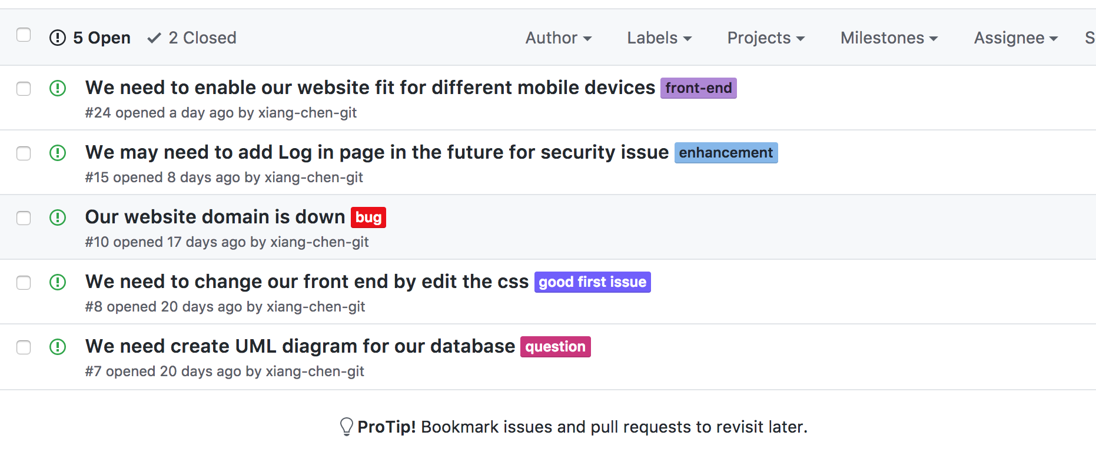
Integration
*
Leverage Github for integration
Maintain Code Change History
Manage Pull Request
Figure Out Issues
Notes:
‹#›

Slide 21
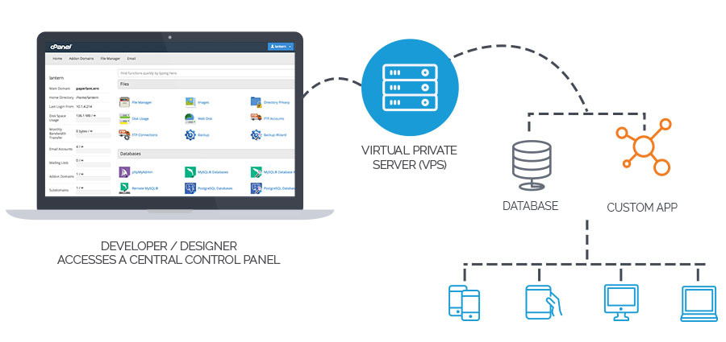
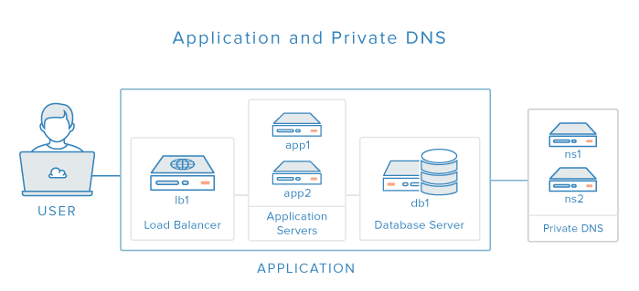
Deployment
*
Linux Server (Ubuntu) ---> Install Apache ---> Install PHP ---> Install MySQL Server --- > Create Database
---> Setup Configuration ---> Upload project code ---> Deploy Website
Notes:
‹#›

Slide 22
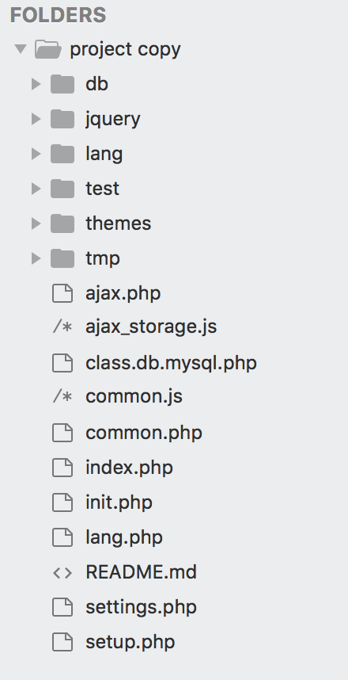
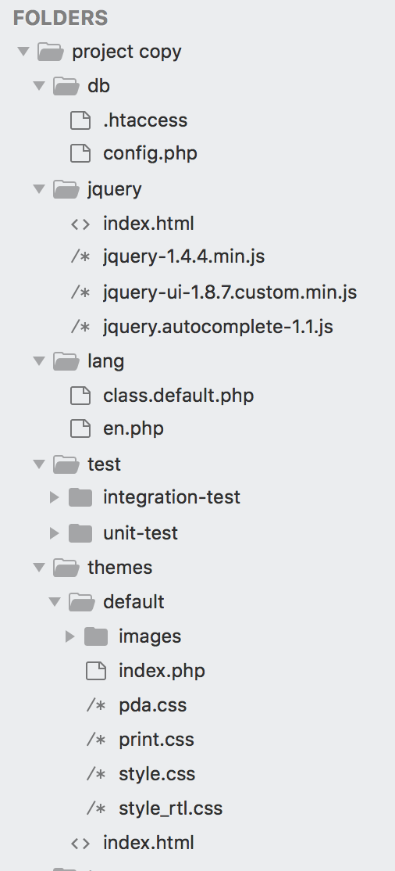
Project Structure
Name | Attribute | Purpose
db | Folder | Contains all database files
jquery | Folder | Contains all JQuery library
lang | Folder | Contains all php files about display language (By default English)
test | Folder | Contains unit test and integration test
themes | Folder | Contains all front-end files (html, css, homepage php)
ajax.php | Php | Php file to perform Ajax
ajax_storage.js | Javascript | Javascript file to perform Ajax
index.php | Php | Homepage php file
setup.php | Php | Deployment (should be deleted after deployment)

Slide 23
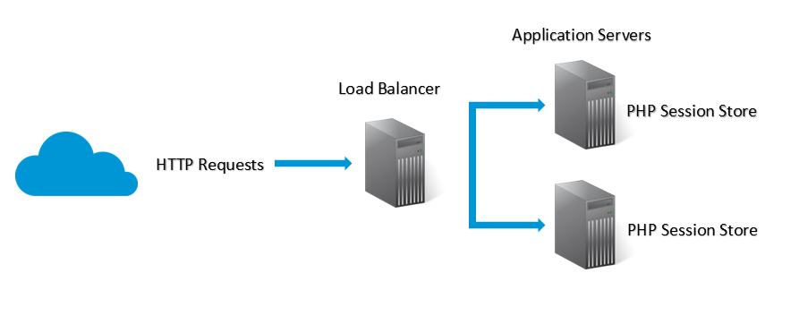
Technique
Sessions are a simple way to store data for individual users against a unique session ID.
This can be used to persist state information between page requests.
Session IDs are normally sent to the browser via session cookies and the ID is used to retrieve existing session data.
The absence of an ID or session cookie let’s PHP know to create a new session, and generate a new session ID.
A session is a way to store information (in variables) to be used across multiple pages. Unlike a cookie, the information is not stored on the user’s computer.

Slide 24

Technique
AJAX = Asynchronous JavaScript And XML. AJAX is not a programming language. AJAX just uses a combination of: 1. A browser built-in XMLHttpRequest object (to request data from a web server)
2. JavaScript and HTML DOM (to display or use the data)
AJAX allows web pages to be updated asynchronously by exchanging data with a web server behind the scenes. This means that it is possible to update parts of a web page, without reloading the whole page.

Slide 25
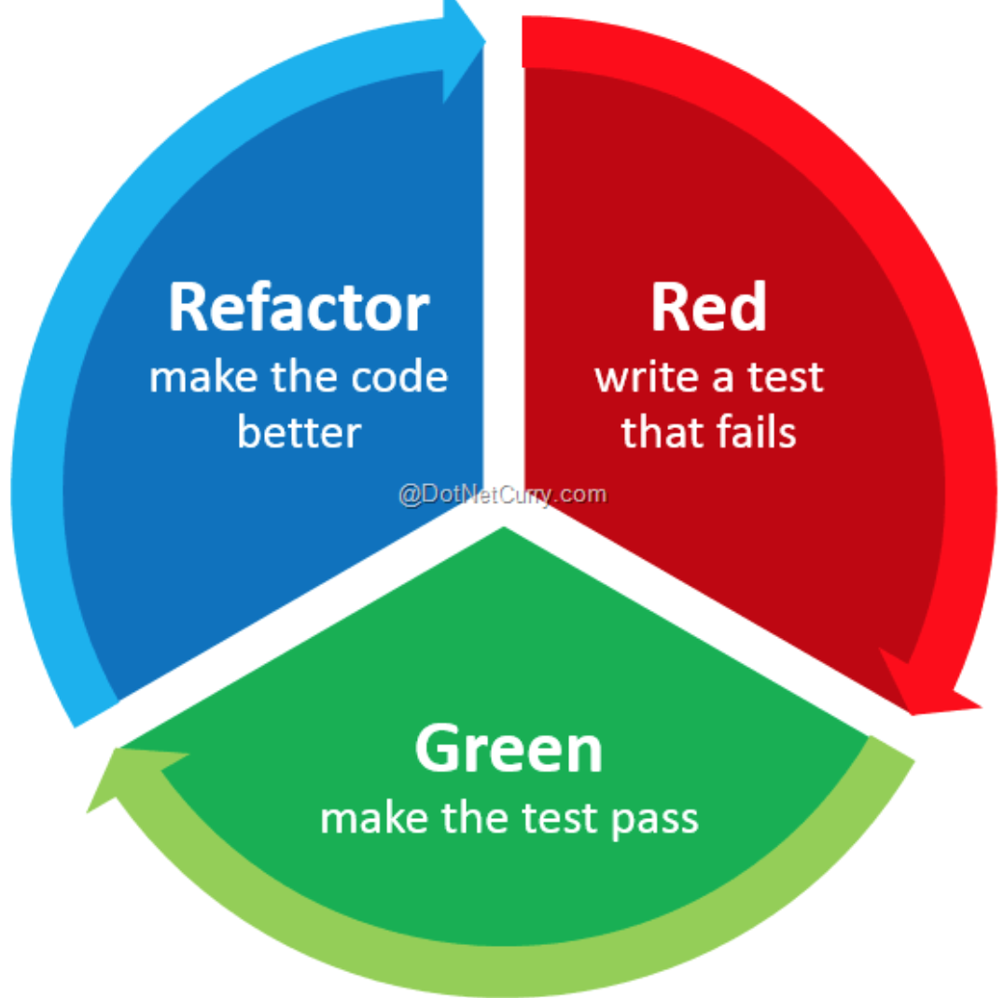
Refactor
Refactor Techniques
Composing methods
Moving Features Between Objects
Organizing Data
Simplifying Conditional Expressions
Simplifying Method Calls
Deal with Generalization
Bad Smell
Large Class
Temporary Field
Duplicate Code
Incomplete Library Class
Middle Man

Slide 26
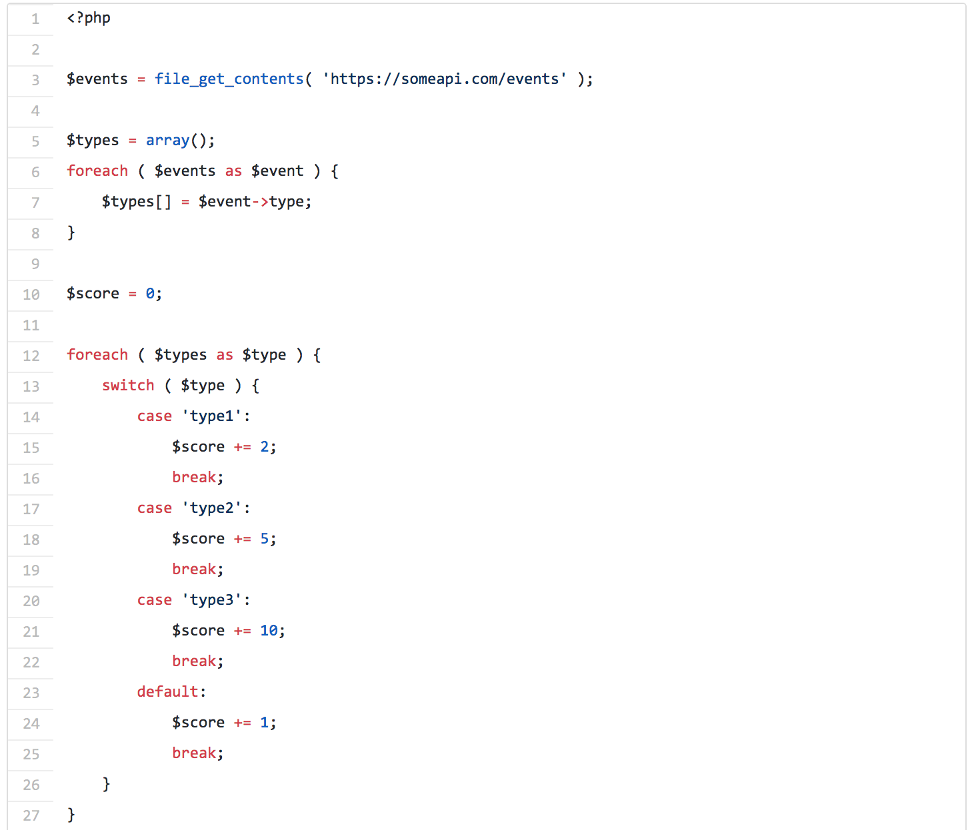
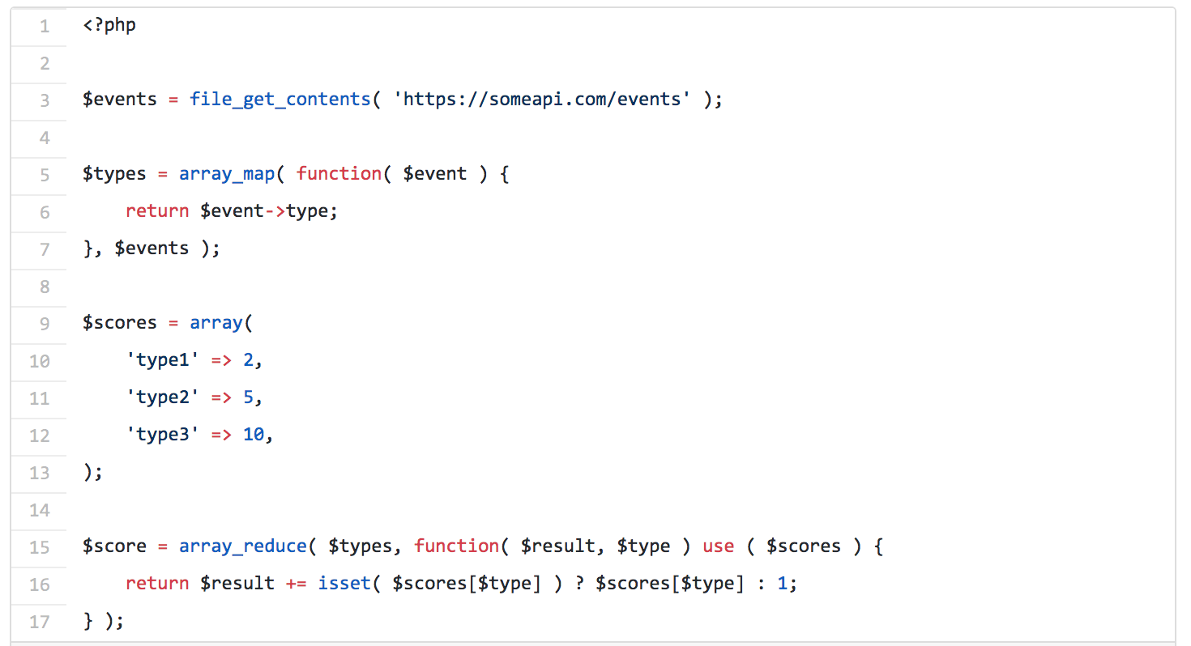
Refactor Example
Refactoring Loops and Conditionals Using Functional Methods

Slide 27
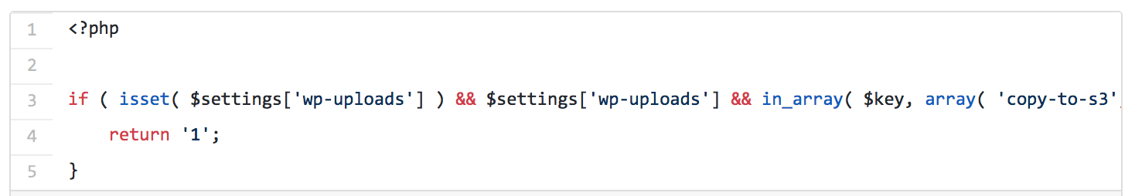
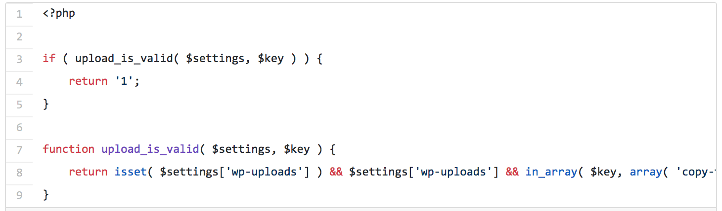
Refactor Example
Splitting Up Complex Conditionals

Slide 28

Testing - Lu Min
Domain Testing
Testing Procedure
Testing Metrics

Slide 29
Domain Testing
Variables | Valid case equivalence classes | Invalid case equivalence classes | Boundaries and special cases
Username | Signed up users | Not signed up users | Signed up users
User story title | “test” | “ ” | \
Sprint name | “Sprint 1” | “”, or too long | \
User story tag | “core” | “”, or too long | \
User story description | “Mainly for testing” | \ | \
User story point | “+1”, “not selected” | “+6” | “+1”~”+3”, “not selected”
Search user story | “test” | “ ”, or user story not exist | Completed User stories
Shown tag | “Core”, “minor” | Not created tag | Created tags

Slide 30


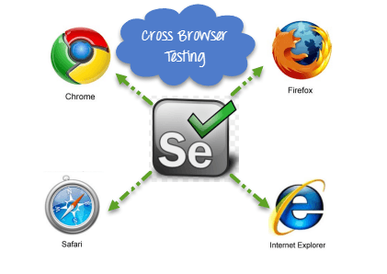
Testing Procedure
Unit test
Javascript unit test - Jasmine
PHP unit test - Codeception
Integration test - Selenium
Acceptance test - Codeception
Compatibility test
Usability test

Slide 31
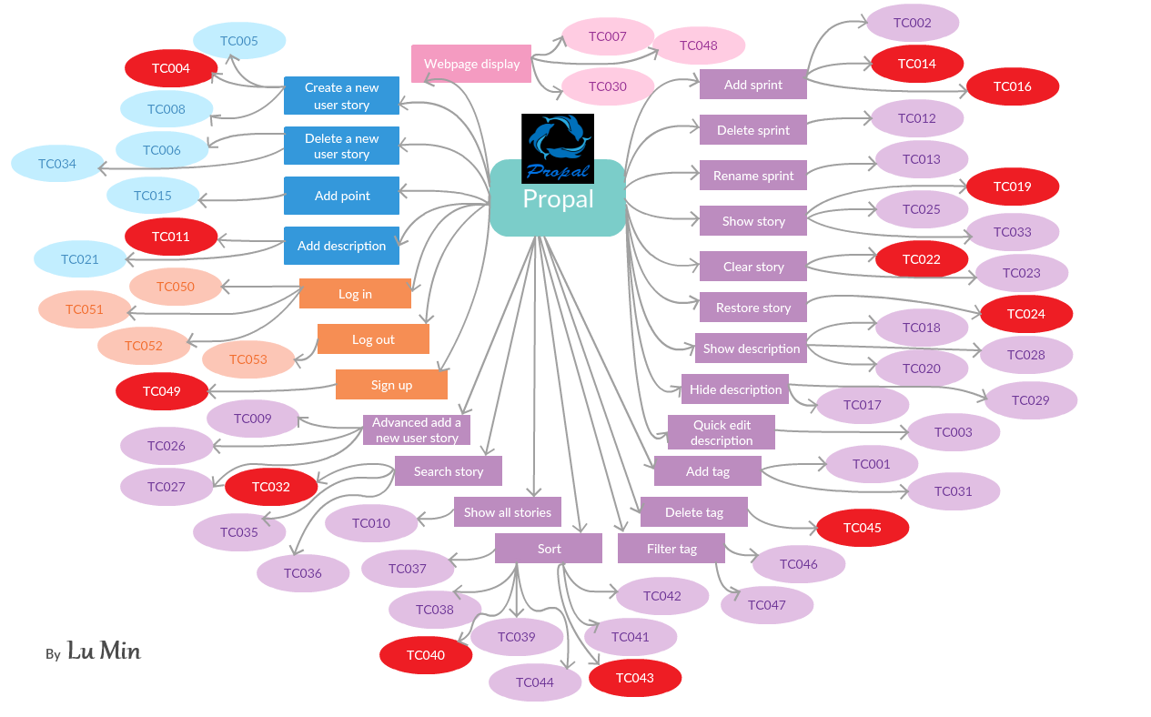

Slide 32
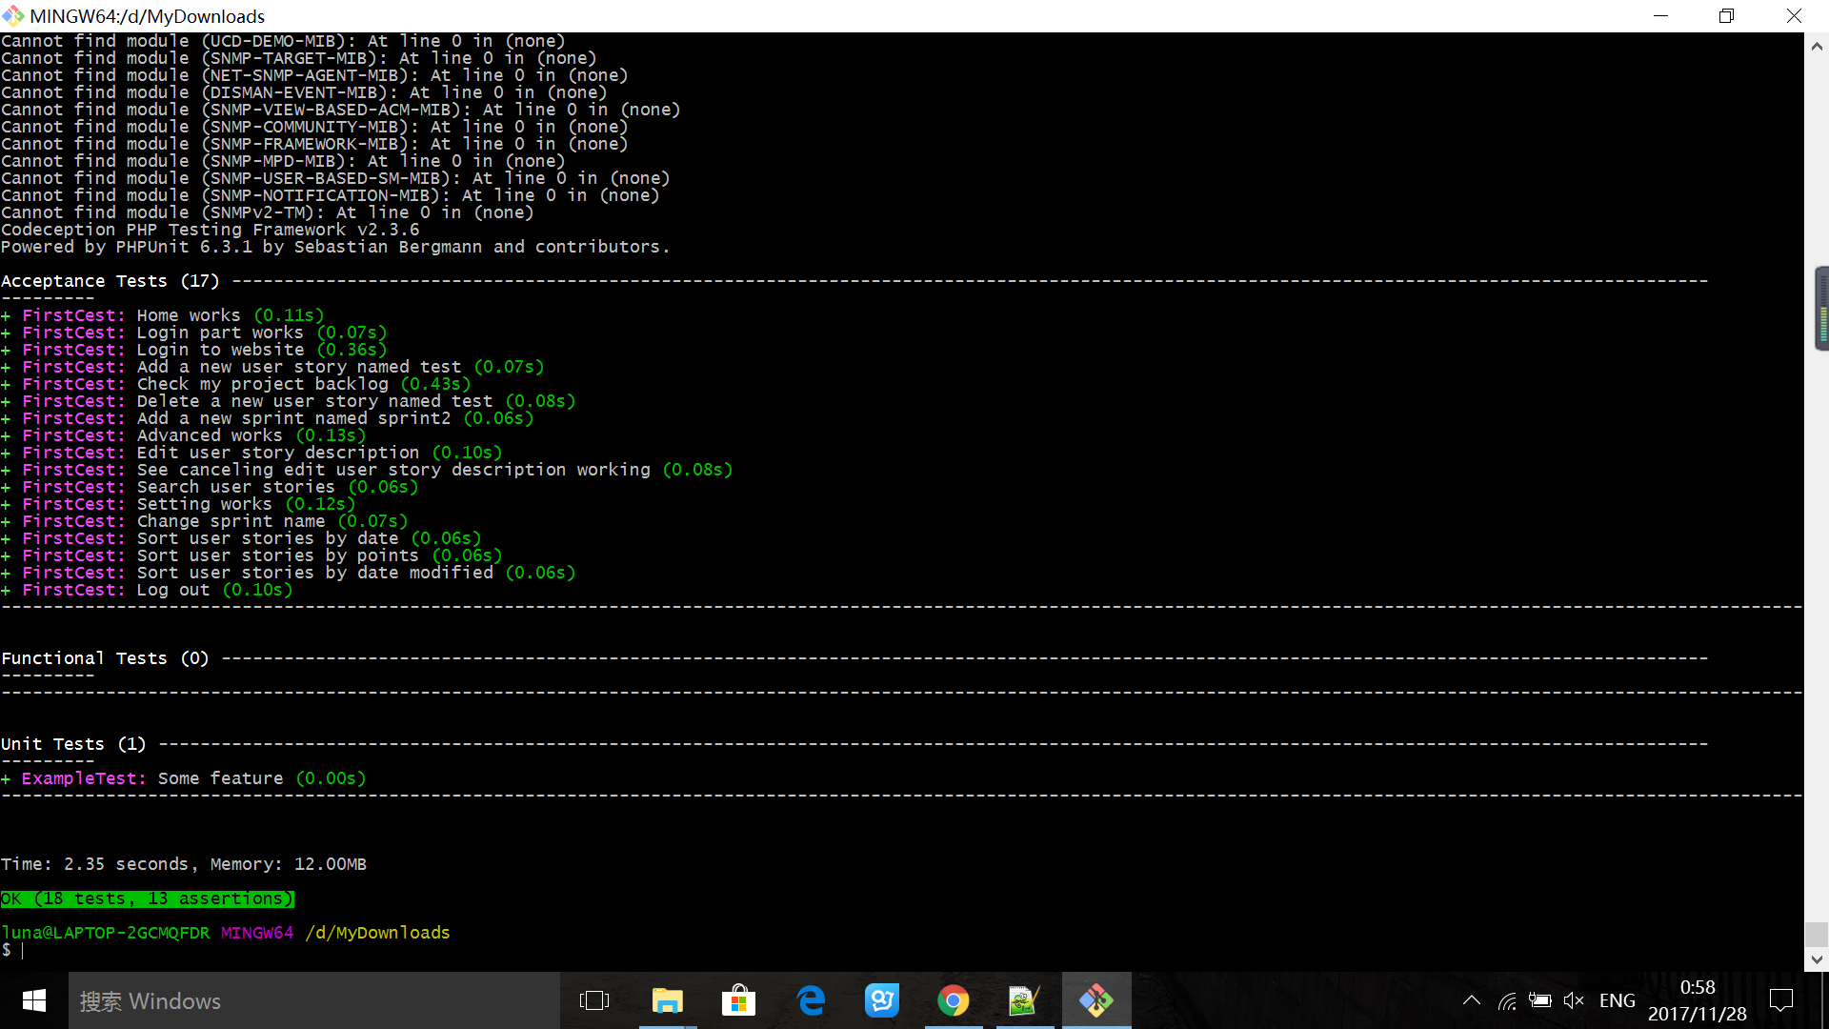
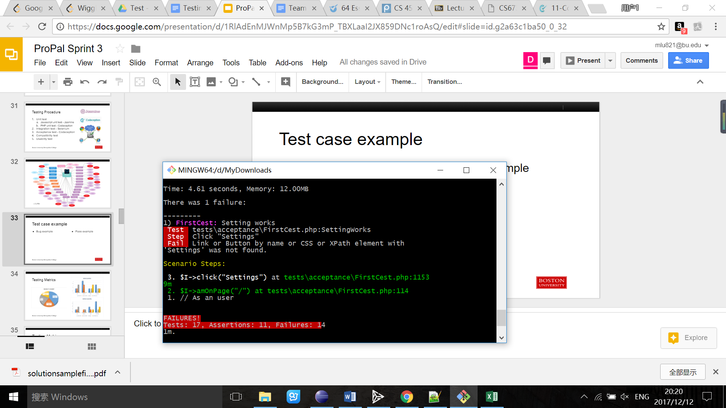
Test case example
Bug example
Pass example

Slide 33
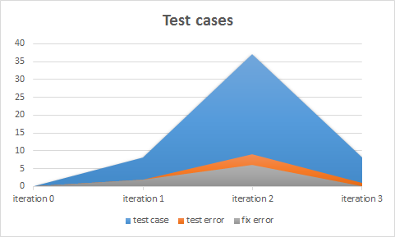
Testing Metrics - test case

Slide 34
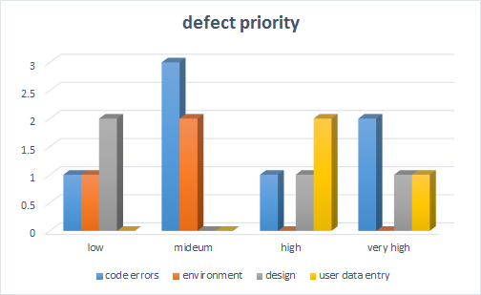
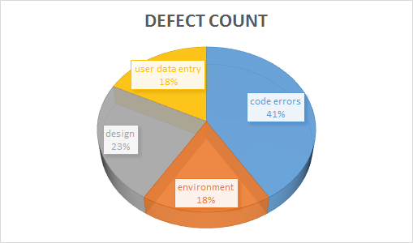
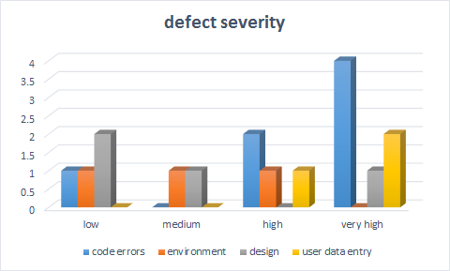
Testing Metrics - defect

Slide 35
Testing Metrics
Sprint # | Line of Code (lines) | Total Effort (man hour) | Document Produced (pages) | Errors Found in Test (count) | Defects found in sprint (count) | User Story Implemented (count)
Sprint0 | 10 | 159 | 24 | 0 | 0 | 0
Sprint1 | 1458 | 166 | 72 | 10 | 3 | 3
Sprint2 | 3546 | 192 | 95 | 12 | 9 | 19
Sprint3 | 2389 | 196 | 59 | 4 | 5 | 3

Slide 36
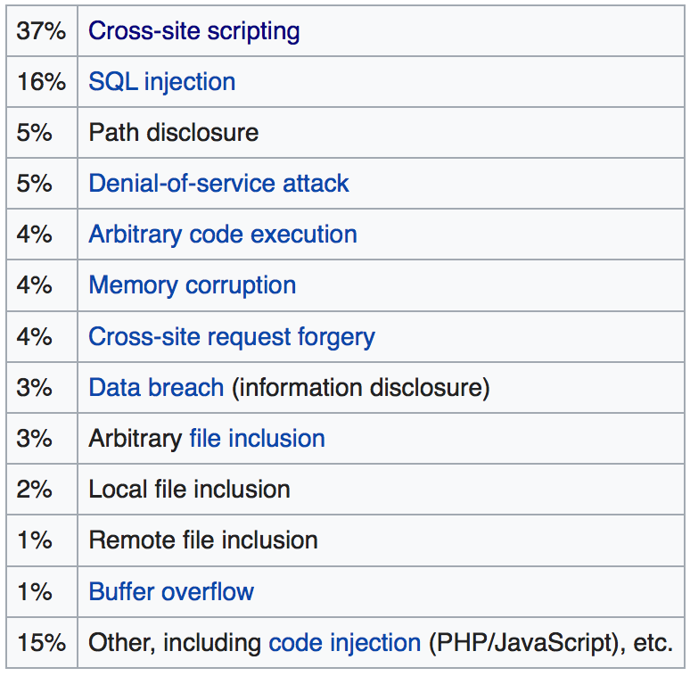
Security(Weicheng Yu)
Cross-site scripting(XSS) accounted for roughly 84% of all security vulnerabilities as of 2007
HackerOne in 2017 reported that XSS is still a major threat
Cenzic made this graph on the right in March 2012
Notes:
Hi everyone, I am Weicheng, the security leader of Team 3. I will talk about security related efforts we make in this project. First, I did some research about what kind of security issues are we facing. It turns out that majority of attack come from Corss-site Scripting(XSS) and SQL injection. On the image at the right hand side you can see a list of website security issues from the most common to the least. This chart was made in March of 2012 by Cenzic but HackerOne in 2017 still report that XSS is a major threat to website security.

Slide 37
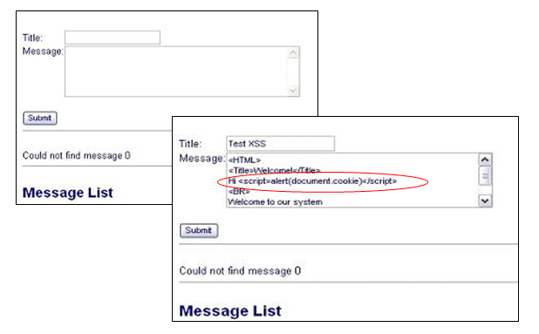
Security - Issues we address
Cross-site scripting(XSS)
SQL injection
Both try to run malicious code via user input area
Notes:
Coming to the next slide, so we have seen what website security issue may look like. Now how we deal with it. Due to time limit, we choose the most common issue.

Slide 38
Security - XSS
XSS tries to steal information via running malicious javascript code
Example
Normal Search URL: http://bobssite.org?q=puppies
XSS: http://bobssite.org?q=<script%20type='text/javascript'>alert('xss');</script>
Notes:
When she visits the Search page, she inputs a search term in the search box and clicks the submit button. If no results were found, the page will display the term she searched for followed by the words "not found," and the url will be http://bobssite.org?q=her search term.
With a normal search query, like the word "puppies", the page simply displays "puppies not found" and the url is "http://bobssite.org?q=puppies" - which is perfectly normal behavior.
However, when she submits an abnormal search query, like "<script type='text/javascript'>alert('xss');</script>",
An alert box appears (that says "xss").
The page displays "<script type='text/javascript'>alert('xss');</script> not found," along with an error message with the text 'xss'.
The url is "http://bobssite.org?q=<script%20type='text/javascript'>alert('xss');</script> - which is exploitable behavior.

Slide 39
Security - XSS Rules
3 Rules we enforced to prevent XSS
Rule #0 - Never Insert Untrusted Data Except in Allowed Location
Rule #1 - HTML Escape Before Inserting Untrusted Data into HTML Element Content
Rule #2 - Attribute Escape Before Inserting Untrusted HTML Common Attributes

Slide 40
Security - SQL Injection
SQL Injection tries to steal information via executing nefarious SQL statement
Vulnerable statement: "SELECT * FROM users WHERE name = ' " + userName + " ';"
SELECT * FROM users WHERE name = ' ' OR '1'='1';
We implement escaping to prevent SQL Injection

Slide 41
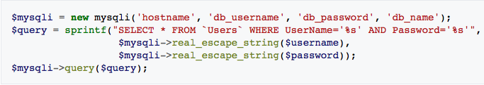
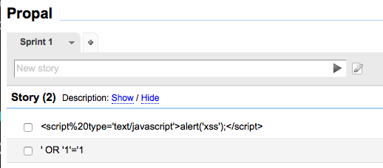
Security - SQL Injection Escaping

Slide 42
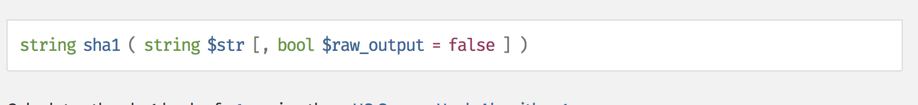
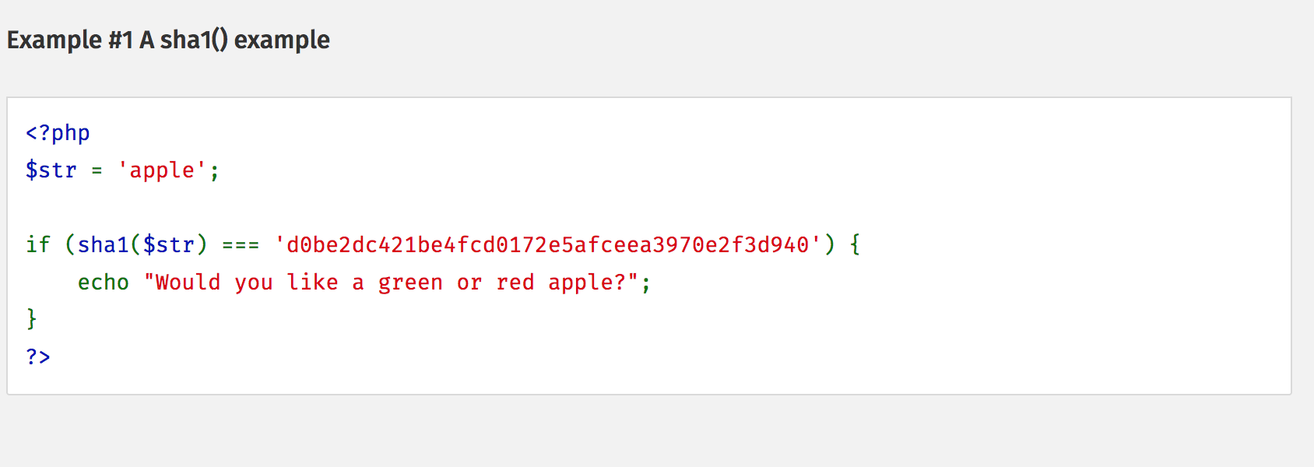
Security - Hashing
To protect the privacy of user data, we encrypt the sensitive data stored in the database using SHA-1
We leverage the sha function in php

Slide 43


Project Management
Proposal
Contribution
Design, Testing, Implementation
Risk Management
Quality Management
Process Improvement
Iteration Evolution
Achievement, Challenge, Lesson Learned

Slide 44



Project Proposal
Why ProPal?
Related works
Scrum
Access Control
Concise

Slide 45
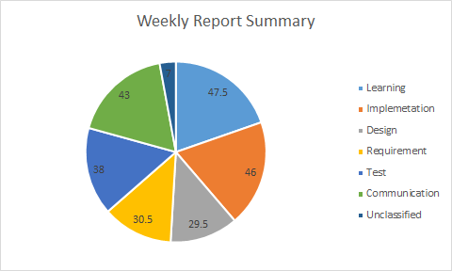
Contribution: (Man-hour summary)
Actual Coding:131.5h
=Learning+Implementation+testing=131.5h
Plan Coding: 102.5
41points * 2.5hour/p= 102.5hours
15point, 40h

Slide 46
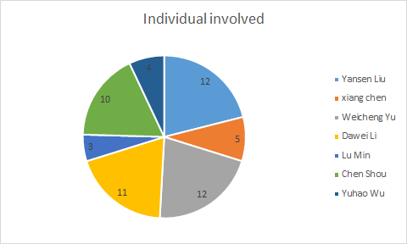
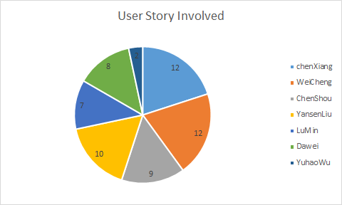
Contribution:
Requirement: Creating User Story
User Story Coding Involved

Slide 47
Design Contribution
Team Member | Contribution in Product Design
Dawei Li | Class diagram, Database ER&Schema, MVC pattern
Xiang Chen | Key Algorithm: Sort, String Parsing and KMP matcher
Yansen Liu | Software system (Packages&Source File), Classes and Methods
Yuhao Wu | Database ER&Schema
Weicheng Yu | Class diagram, Classes and Methods
Chen Shou | Classes and Methods
Lu Min | Classes and Methods

Slide 48
Testing Contribution
Team Member | Contribution in Product Testing
Dawei Li | Test Case, Integration Test (Selenium)
Xiang Chen | Testing Summary, Integration Test(Github)
Yansen Liu | Test Case
Yuhao Wu | Integration test
Weicheng Yu | Javascript Unit Test (Jasmine)
Chen Shou | Test Case
Lu Min | Testing metrics: Defect Count, Defect priority, Defect severity

Slide 49
Implementation Contribution
Team Member | Contribution of Implementation
Dawei Li | General Front-end design and coding, (US: Point display, task edit, sort)
Xiang Chen | Debug(Edit US); Mobile device fitting; Deploy; Login&ACC(PHP)
Yansen Liu | Front-end, (US: add tag; Add story; Show/Hide)
Yuhao Wu | Front-end: Point display, task edit, sort
Weicheng Yu | Point assignment, Sort, Search, New Sprint
Chen Shou | Database implementation, Database Configuration
Lu Min | PHP unit test, Acceptance test code

Slide 50
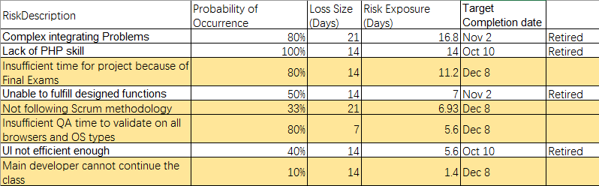
Risk Management
Identify and Track High Priority Risks:

Slide 51
Quality Management
Sprint # | Line of Code (lines) | Total Effort (man hour) | Document Produced (pages) | Errors Found in Test (count) | Defects found in sprint (count) | User Story Implemented (count)
Sprint0 | 10 | 159 | 24 | 0 | 0 | 0
Sprint1 | 1458 | 166 | 72 | 10 | 3 | 3
Sprint2 | 3546 | 192 | 95 | 12 | 9 | 19
Sprint3 |  |  |  | 15 | 13 | 22

Slide 52

Process Improvement

Slide 53

Process Improvement (Con.)

Slide 54

Process Improvement (Con.)

Slide 55

Quality Metrics throughout the project

Slide 56

Iteration evolution

Slide 57

Achievements
•Deep understanding of Agile Software Engineering

Slide 58

Challenges
•Estimate jobs properly
•Integrating

Slide 59


To Be Improved
Task Runner for Front-End & Configuration Automation
Uglify (Minify/Compress)
Local Server
Live Reload & Debug
Prefixing CSS
Concatenating

Slide 60


To Be Improved
Continuous Integration and Automatic Deployment

Slide 61

To Be Improved
User Group Access Control
 | Project Leader | Developer | Designer | Customer
View | Y | Y | Y | Y
Edit | Y | Y | N | N
Begin | Y | Y | Y | N
Close | Y | N | N | N
Sort | Y | Y | Y | N

Slide 62

To Be Improved
Account Registration and Password Update
By Email Server

Slide 63
To Be Improved
Personal account
Create new project
Switch project
Delete project

Slide 64
Demo

